Slide 1
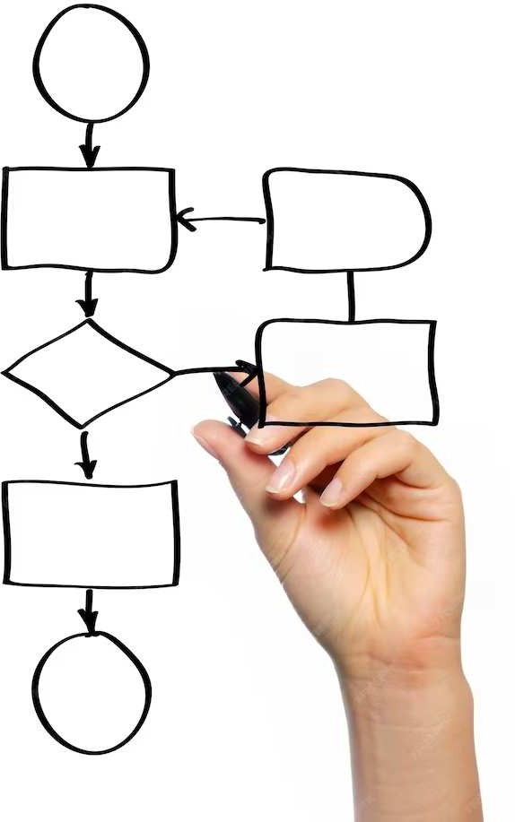
Enhancing Facial E pression Recognition:
Leveraging Dynamic
Local Ternary Patterns with Kernel E treme Learning Machine Classiﬁer

Slide 2
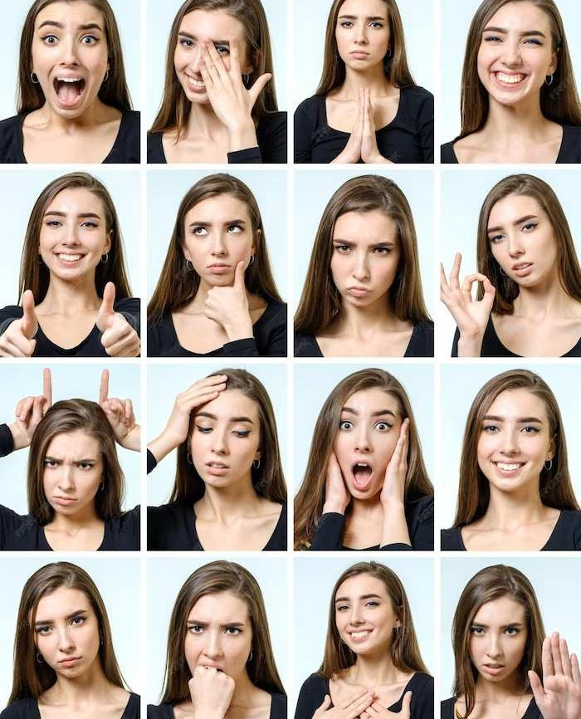

Introduction
This presentation explores Enhancing Facial Expression Recognition using Dynamic Local Ternary Patterns with a Kernel Extreme Learning Machine Classiﬁer. The study aims to improve the accuracy and robustness of facial expression recognition systems. The integration of dynamic local features and advanced machine learning techniques offers promising results in this ﬁeld.

Slide 3
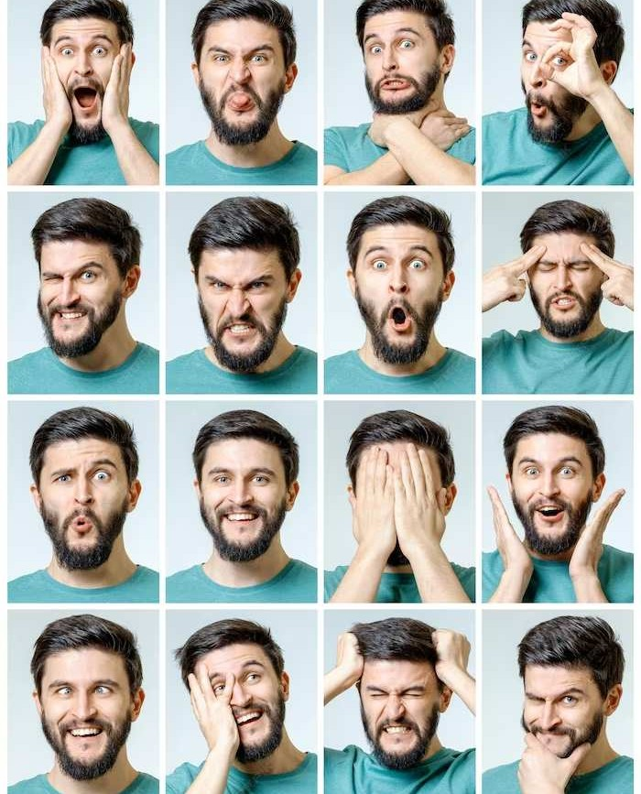
Facial E pression Recognition
Facial Expression Recognition (FER) is the process of automatically identifying human emotions from facial expressions. FER has applications in human-computer interaction, marketing, and healthcare. Accurate FER systems can enhance user experience and provide valuable insights into emotional responses.

Slide 4
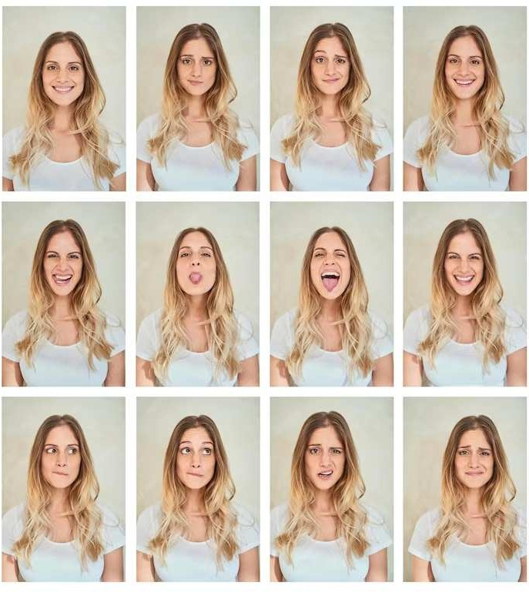
Dynamic Local Ternary
Patterns
Dynamic Local Ternary Patterns (DLTP) capture local facial texture variations over time. DLTP encodes the changes in facial features, providing a richer representation of facial expressions. The temporal dynamics of facial expressions are crucial for understanding subtle emotional cues.

Slide 5
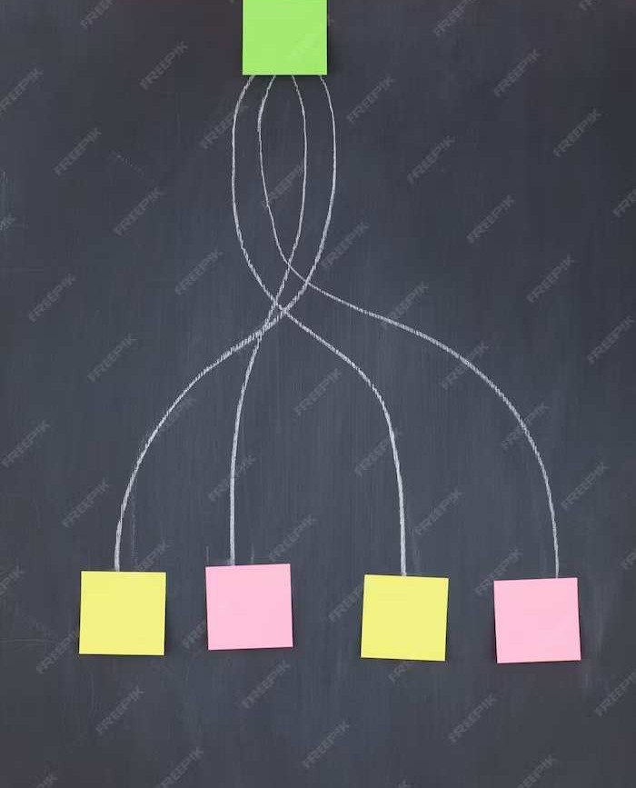

Kernel E treme Learning Machine Classiﬁer
The Kernel Extreme Learning Machine (KELM) classiﬁer is a powerful machine learning algorithm for pattern recognition. KELM efﬁciently handles high-dimensional data and nonlinear relationships. Its application in FER enhances the classiﬁcation of dynamic facial expression features.

Slide 6
Conclusion
In conclusion, the integration of Dynamic Local Ternary Patterns with the Kernel Extreme Learning Machine Classiﬁer offers a promising approach to enhance Facial Expression Recognition. This advancement contributes to the development of more accurate and reliable systems for understanding human emotions.

Slide 7
Thanks!
Do you have any questions? youremail@email.com
+91 620 421 838
www.yourwebsite.com @yourusername

